Slide 1

Building 100% Serverless Blog Site Application with Right Observability
July 10, 2019
Serkan ÖZAL

Slide 2




WHO AM I?
Founder & CEO/CTO @ Thundra
Co-organizer of
Serverless Turkey Meetup
ServerlessDays İstanbul 2019 (3rd of October)
Oracle Open Source Contributor
In serverless era since 3 years
PhD candidate
@serkan_ozal
serkan-ozal

Slide 3
AGENDA
What We Gonna Do?
What We Gonna Use?
The Architecture
Monitoring with CloudWatch
Monitoring with Thundra
How to Setup
Local & Distributed Tracing
Invocation Tagging
Async Monitoring
More Thundra Features

Slide 4
WHAT WE GONNA DO?

Slide 5
The Blog Site Application
Send Blog Post
Get Blog Post
Search Blog Post
Delete Blog Post

Slide 6

Reference implementation available at
github.com/thundra-io/serverless-blog-site-workshop

Slide 7
WHAT WE GONNA USE?

Slide 8





Slide 9
THE ARCHITECTURE

Slide 10
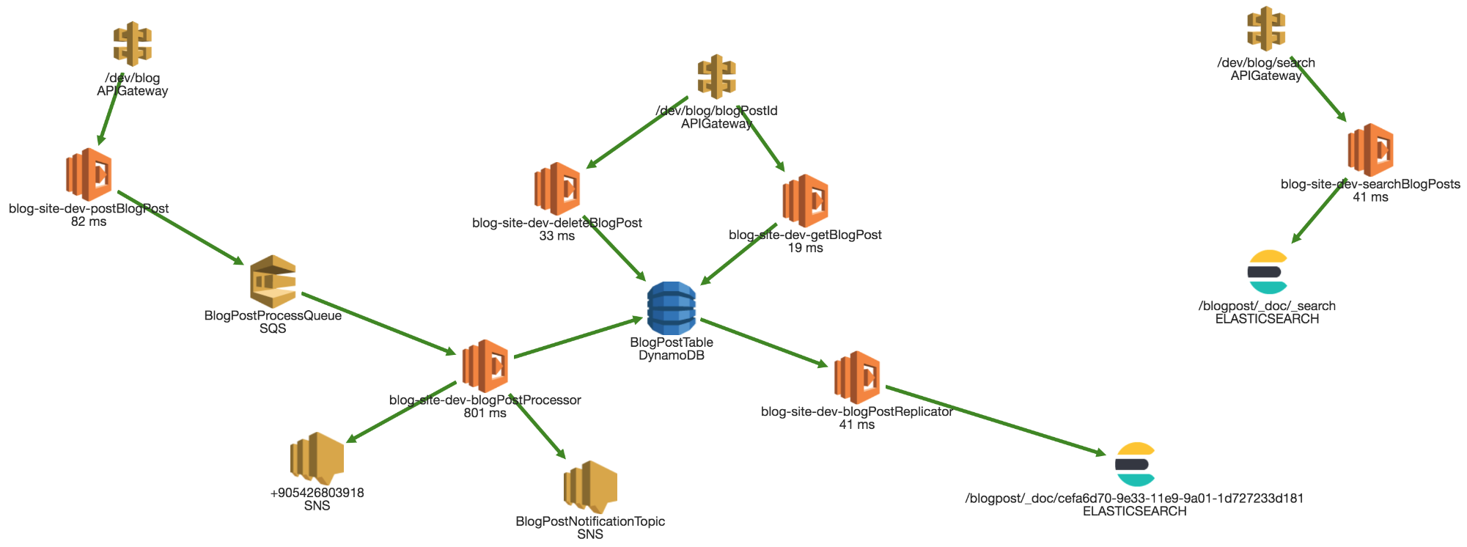

Slide 11
Send Blog Post

Slide 12
Get Blog Post

Slide 13
Search Blog Post

Slide 14
Delete Blog Post

Slide 15
MONITORING WITH CLOUDWATCH

Slide 16
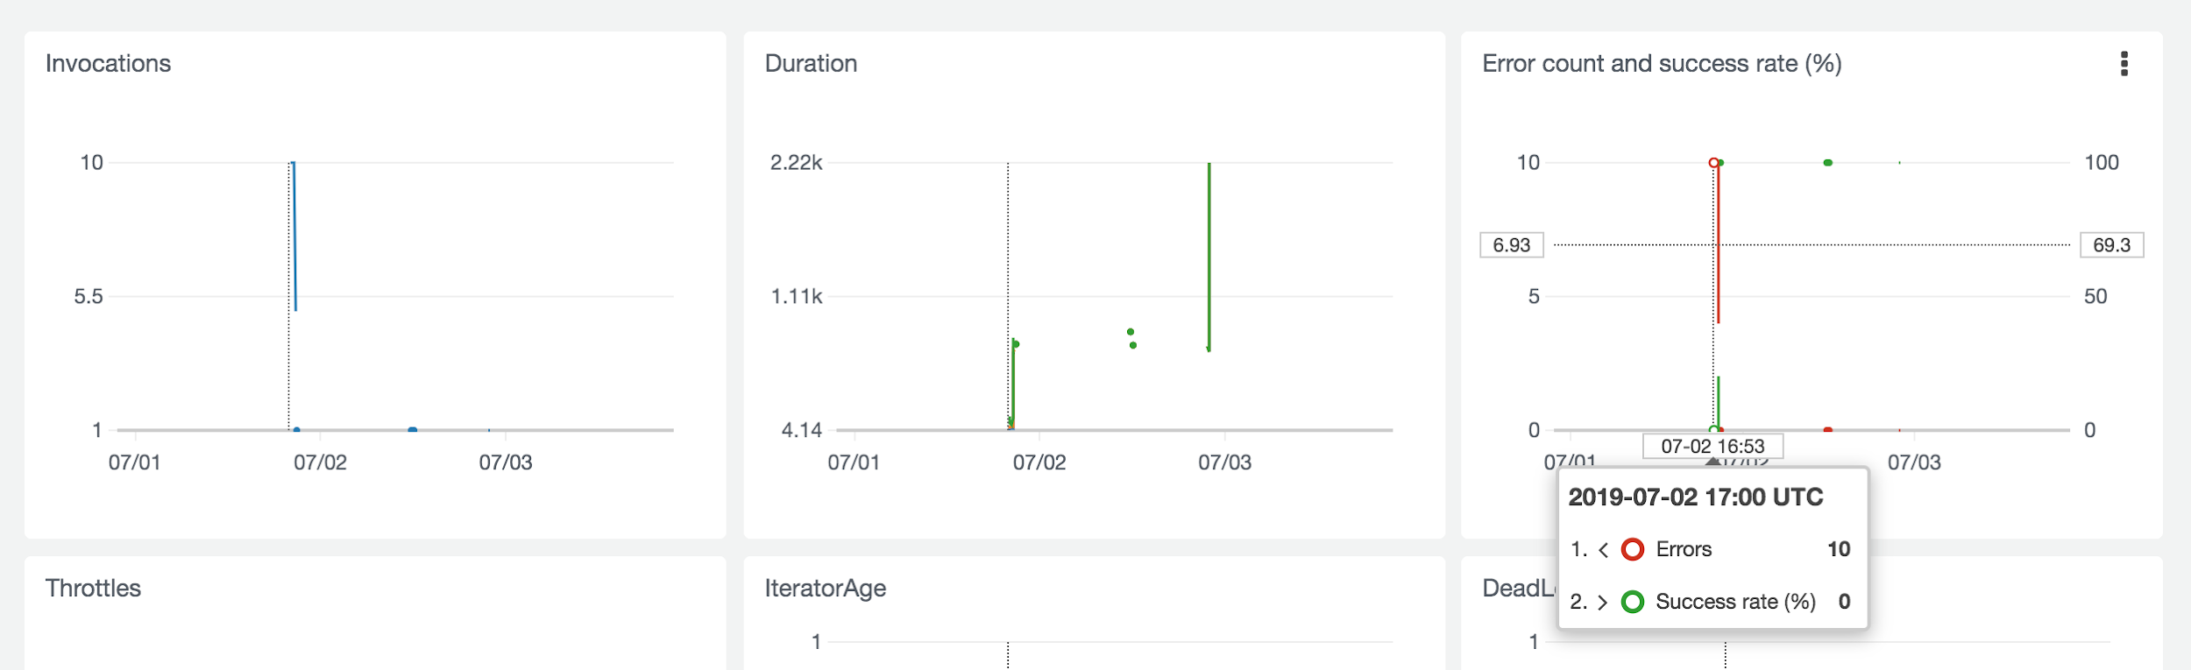
So What?

Slide 17
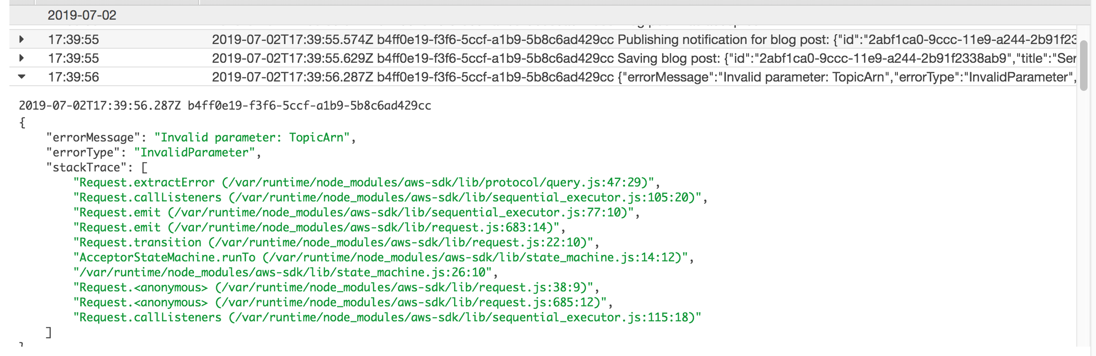
Finding Needles in Haystacks

Slide 18
MONITORING WITH THUNDRA

Slide 19

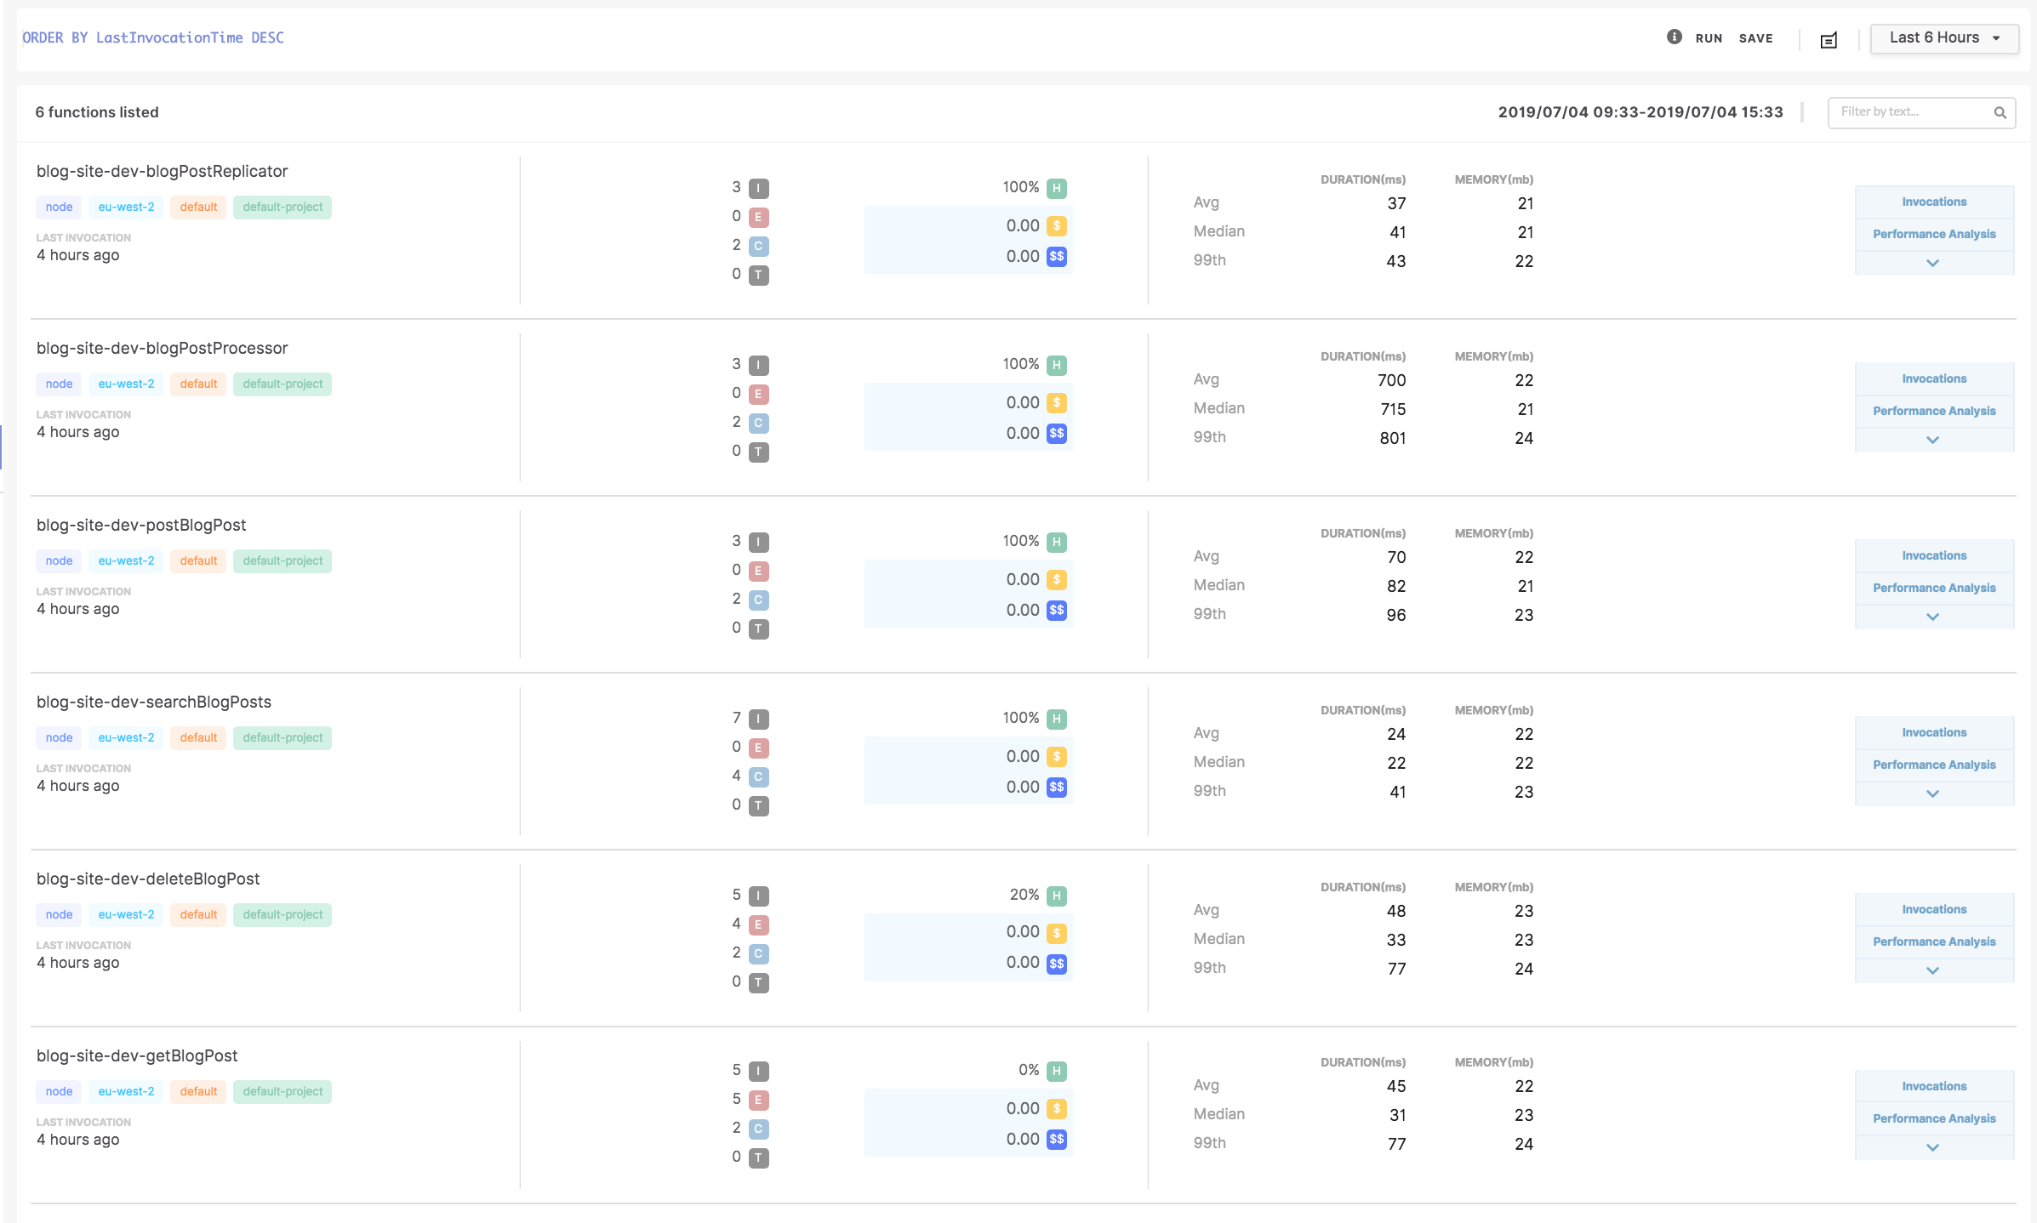
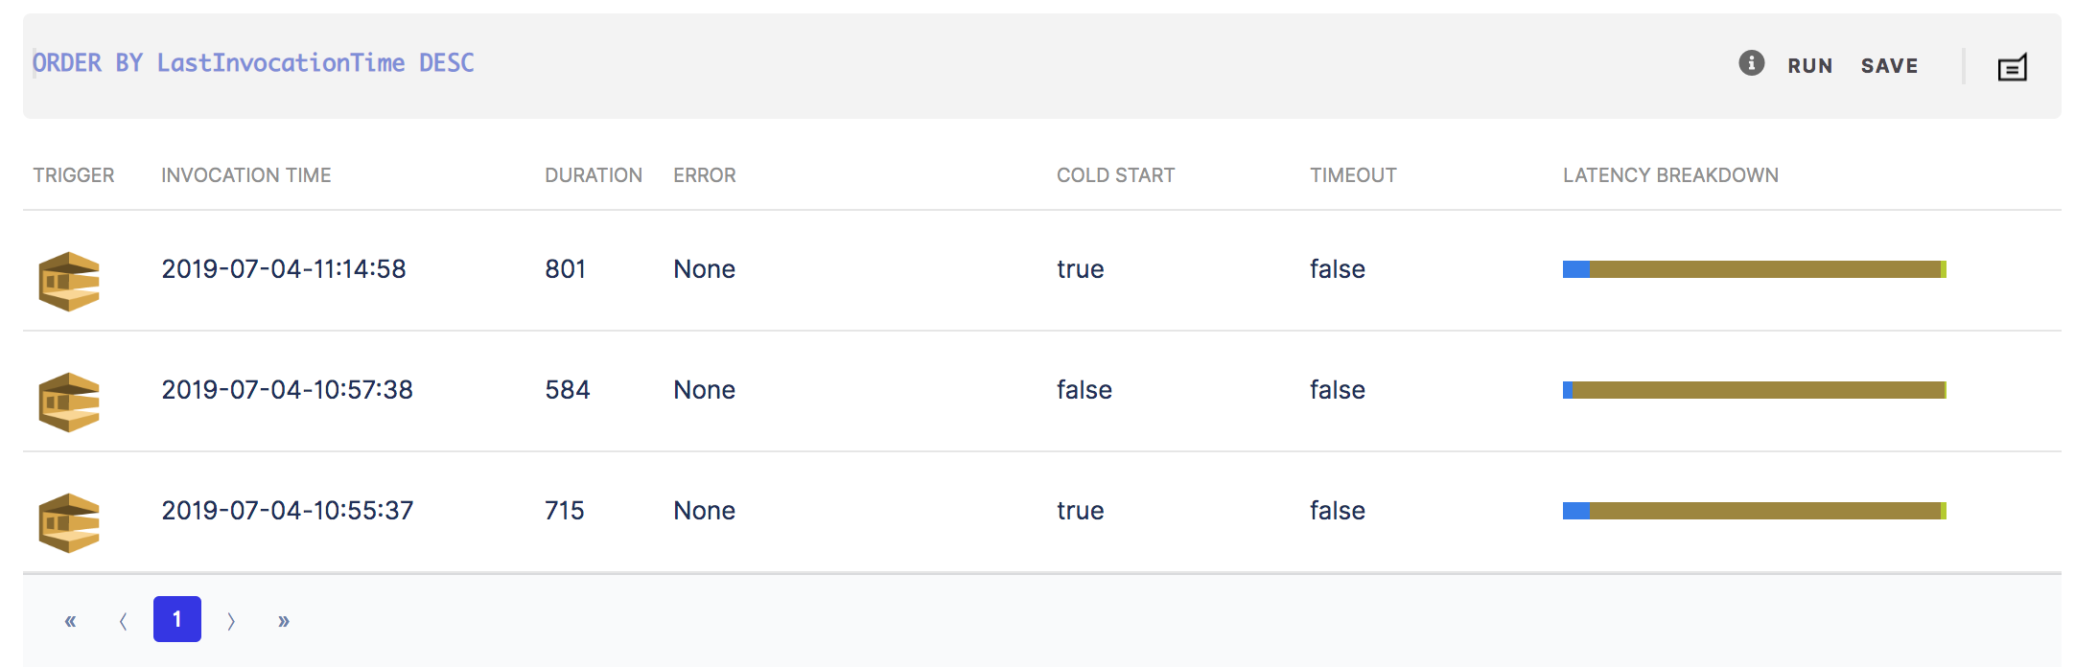
How to Setup
Add Thundra layer
Get and set Thundra API key
Happy monitoring!!!

Slide 20
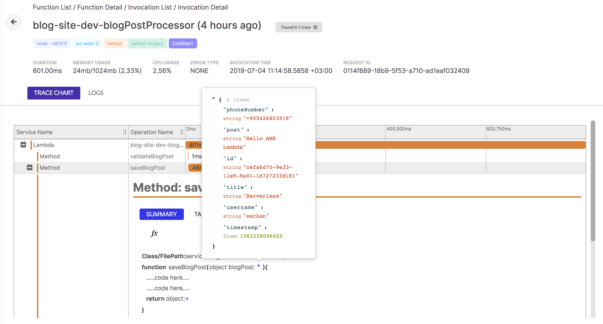
Local Tracing

Slide 21
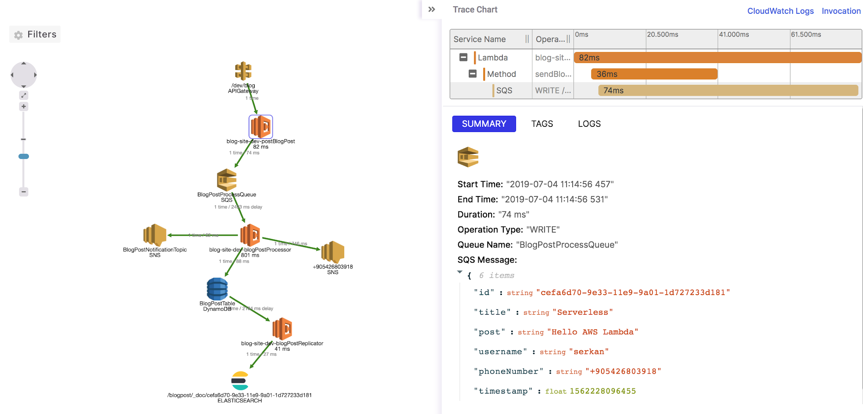
Distributed Tracing
Integrated with all of the most used AWS services
Supports multiple upstream transaction

Slide 22
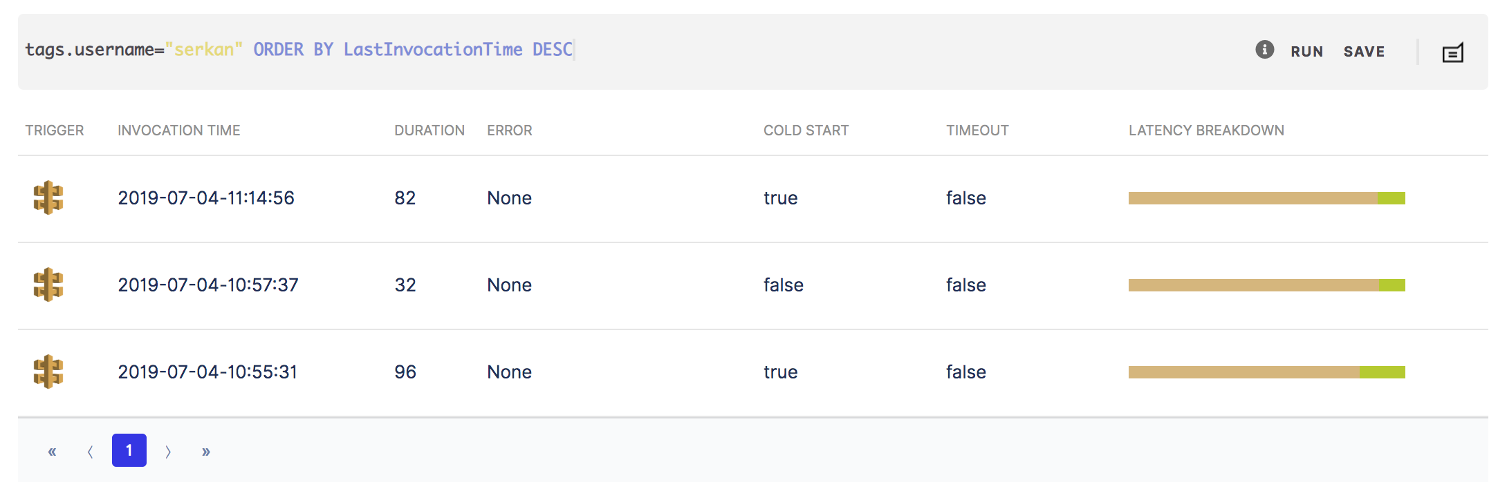
Invocation Tagging

Slide 23

Async monitoring
No network delay
Even works in VPC
Add Thundra Serverless CloudWatch plugin
Enable CloudWatch based reporting

Slide 24
MORE THUNDRA FEATURES

Slide 25
OpenTracing API/Spec Compatible
OpenTracing compatible API
OpenTracing specification compatible data model
Easy to integrate with other APM solutions
Honeycomb
github.com/opentracing/specification/blob/master/specification.md

Slide 26
Intelligent Sampling
Samples periodically at every
N invocation
N seconds/minutes
Samples when
duration exceeds given threshold
invocation fails with any (or specific) error
CPU/Memory usage exceeds threshold
Custom: Implement your own sampler

Slide 27
Alerting
Highly customizable alerts to create your own way of keeping eye on your system.
Actionable insights to reduce the MTTR
Customizable notification rules to your preferred channel and channels
Different severity levels to prevent the alert fatigue in your organization

Slide 28
Your Data at Your Instance
Thundra never see your data
Splunk
stored at your Splunk deployment
Thundra provides Splunk App to visualize your data
or run your own queries
Elasticsearch
stored at your Elasticsearch instance/clıster
Thundra provides Kibana plugin to visualize your data
or run your own queries

Slide 29

Thank you !
Notes:
Thanks for listening me. This is the end of presentation. I would like to answer you questions about serverless or Thundra if you have.

